Slide 1
Client Name
Notes:
Thank you for joining us as we cover your company’s Health Reimbursement Arrangement.
This presentation is being presented by WEX. My name is ____________ and I am happy to be here with you today!

Slide 2
Health reimbursement arrangement
(HRA)
Notes:
During our presentation today, I will be reviewing what a health reimbursement arrangement, or HRA, is and why you should consider enrolling in an HRA.

Slide 3
What is a health reimbursement arrangement (HRA)?
Designed and funded by your employer
Can offset costs not covered by your group health plan
Notes:
A health reimbursement arrangement (or HRA) is a benefits plan that reimburses you for eligible expenses to help offset costs not covered by your group health plan.
What makes an HRA different from a Health Savings Account or a Flexible Spending Account is that an HRA is entirely funded by your employer. Because of this, your involvement in an HRA does not count against your taxable income.
After your employer contributes funds to your HRA, you can start spending those funds on eligible expenses, set by your employer’s plan design.
Unused amounts cannot be cashed out. Your employer may have a rollover amount, where a portion of the funds can be carried over to the next year’s plan.

Slide 4

HRAs are customizable
How your HRA plan functions is determined by your employer
  When funds are contributed to the plan and when the funds are available
  What expenses are eligible for reimbursement
Notes:
Because HRAs are so customizable, no two plans look the same! Here are some of the ways your employer could customize the design of an HRA.
Your employer has control over how much they contribute to the plan and whether any funds carry over to the next plan year.
Your employer also determines when contributions become available. This could be 100% at the beginning of the plan year, scheduled throughout the year, or after criteria has been met, like hitting a deductible.
Your employer also determines the expenses eligible for reimbursement. Depending on the HRA’s eligible expenses, you may or may not be able to participate in a Health Savings Account (HSA).
Be sure to ask a representative from your human resources team for the specifics of your HRA plan.

Slide 5

What does your HRA cover?
Eligible expenses are determined by your employer but may include expenses such as:
  Insert eligible expense
  Insert eligible expense
  Insert eligible expense
Notes:
***Insert eligible expenses for client’s specific HRA on both slide and script ***
Your employer also determines what expenses are eligible for reimbursement. Check out the list on the screen to see some of the items eligible for reimbursement through your HRA.

Slide 6

Your HRA Threshold
Once you pay the predetermined deductible amount, your HRA funds can pick up the remainder.
Deductible amounts
Employee: $####
Family: $ ####
Notes:
****If the client has a threshold HRA can use this slide and modify to what your client has***
Your employer has designed your HRA with a threshold. It works like this: you pay the first portion of your healthcare expenses, up to an amount pre-determined by your employer. This is called the deductible. After the deductible has been paid, the HRA picks up the remainder.
The deductible amounts for your HRA are $xxx for an employee only, or $xxxx if your whole family is covered by the HRA.

Slide 7
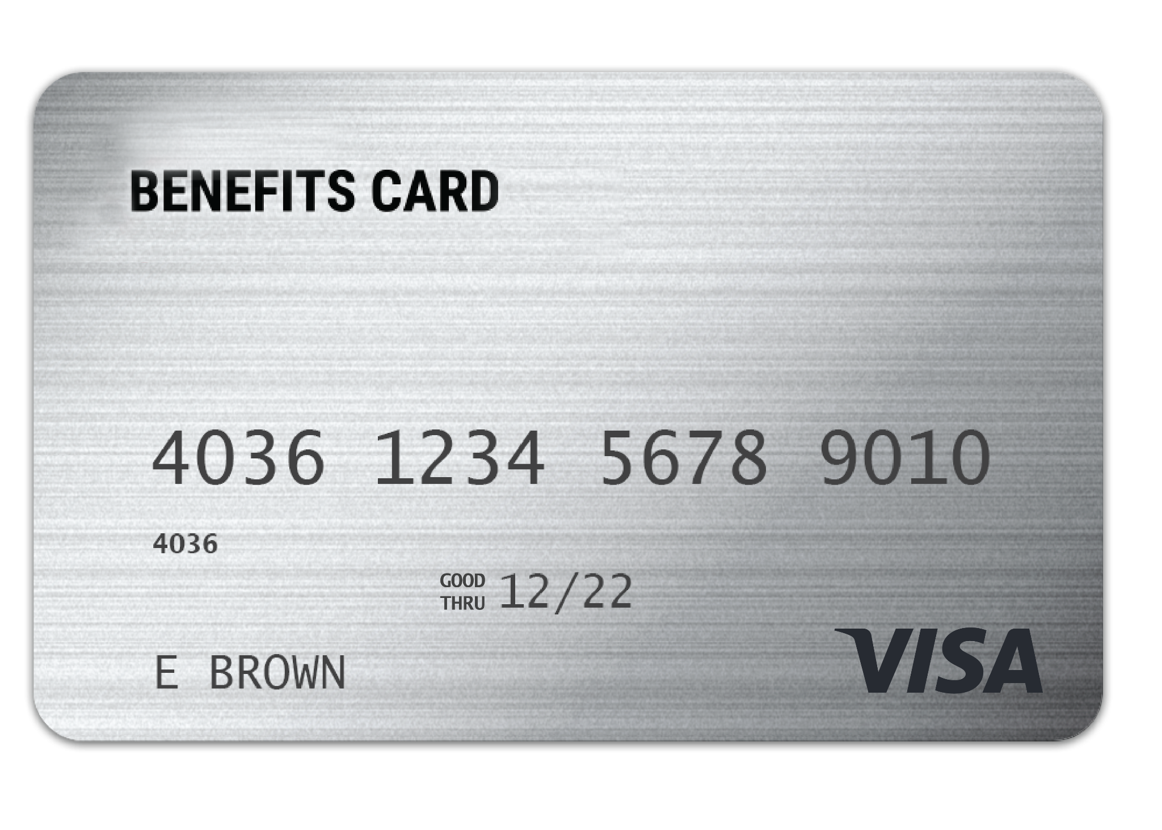
WEX benefits card
Free benefits card
Minimize the amount of out-of-pocket spending
Valid for three years
Instant access to plan funds
Notes:
Your enrollment in any of our plans includes our free benefits debit card. This allows you to easily access your funds right from your wallet to help you minimize the amount of out of pocket spending.
If you already have our debit card, they are good for 3 years, so if you received one within the last 2 years you will not get a new one again next year. We will mail you a new debit card 90 days before the expiration date of your current debit card. All new cards will be good for 4 years.
Regardless if you are enrolled in a FSA, DCA, or other WEX benefits you will use the same card.
If your card is lost or stolen, you can order a new card free of charge from the benefits mobile app or by going through your online account.
The WEX Benefits Debit Card is the most common way that claims against your plan are filed.

Slide 8
Claim filing
Any documentation provided must contain the following information:
  When the service was received
  Where the service was received
  What service was received
  The amount/cost of the service received
  Who received the service
The best form of documentation when submitting a claim is either an explanation of benefits (EOB) from your carrier, or an itemized receipt from your provider
Notes:
Let's talk a bit about documentation! (say jokingly) Everyone loves providing documentation, right?
Now, there are instances where we will reach out to you requesting documentation for your debit card purchase. This is not because we want to keep bothering you, it is because it is an IRS regulation.
Also, if you are submitting a claim via your mobile app, your online account or manually via the mail the best form of receipt or documentation is an Explanation of Benefits as it contains all of the necessary information for WEX to approve your claim. You receive your explanation of benefits (or EOB) from your medical, dental or vision carriers.
Any documentation provided must contain the following information:
When the service was received
Where the service was received
What service was received
The amount/cost of the service received
Who received the service

Slide 9
Claim filing options
Mobile app, online account
or manual claims
Processed within two business days
Choose direct deposit or paper check
Direct deposit – FREE
$25 minimum reimbursement
for paper checks
Notes:
For anything you’ve paid out of pocket, you can also submit claims to be reimbursed by using your mobile app – simply login, select File a Claim and use the easy to follow steps. You can even take a picture of your explanation of benefits or itemized receipt right from your mobile phone!
And of course you can submit a claim thru you online account by following similar steps and uploading your documentation or by submitting the Claim form.
All claims are processed within 2 business days. You can choose to be reimbursed thru direct deposit right to your bank account or have a check mailed to you. Direct deposit is provided free of charge and is a quick and easy way to get your reimbursement!

Slide 10
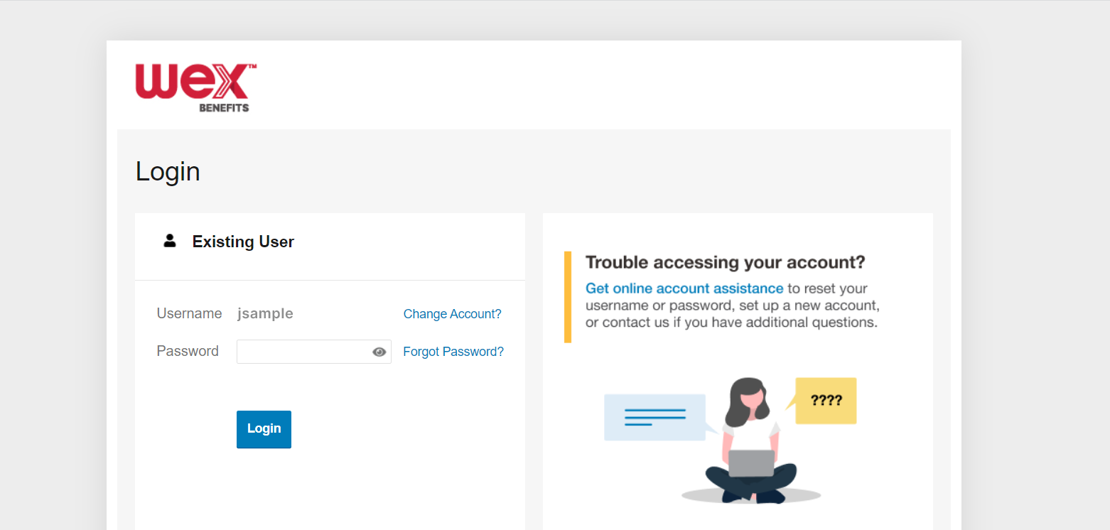

Account Access
Online account
Mobile app
Notes:
Now let’s end with a highlight of how you can access all of your accounts with us.
You can get access your account information by logging into your online account. Here you see details and balances of any accounts with us, transactions, and complete any tasks you’d like or need to take on your account. We also have the free WEX benefits mobile app.

Slide 11
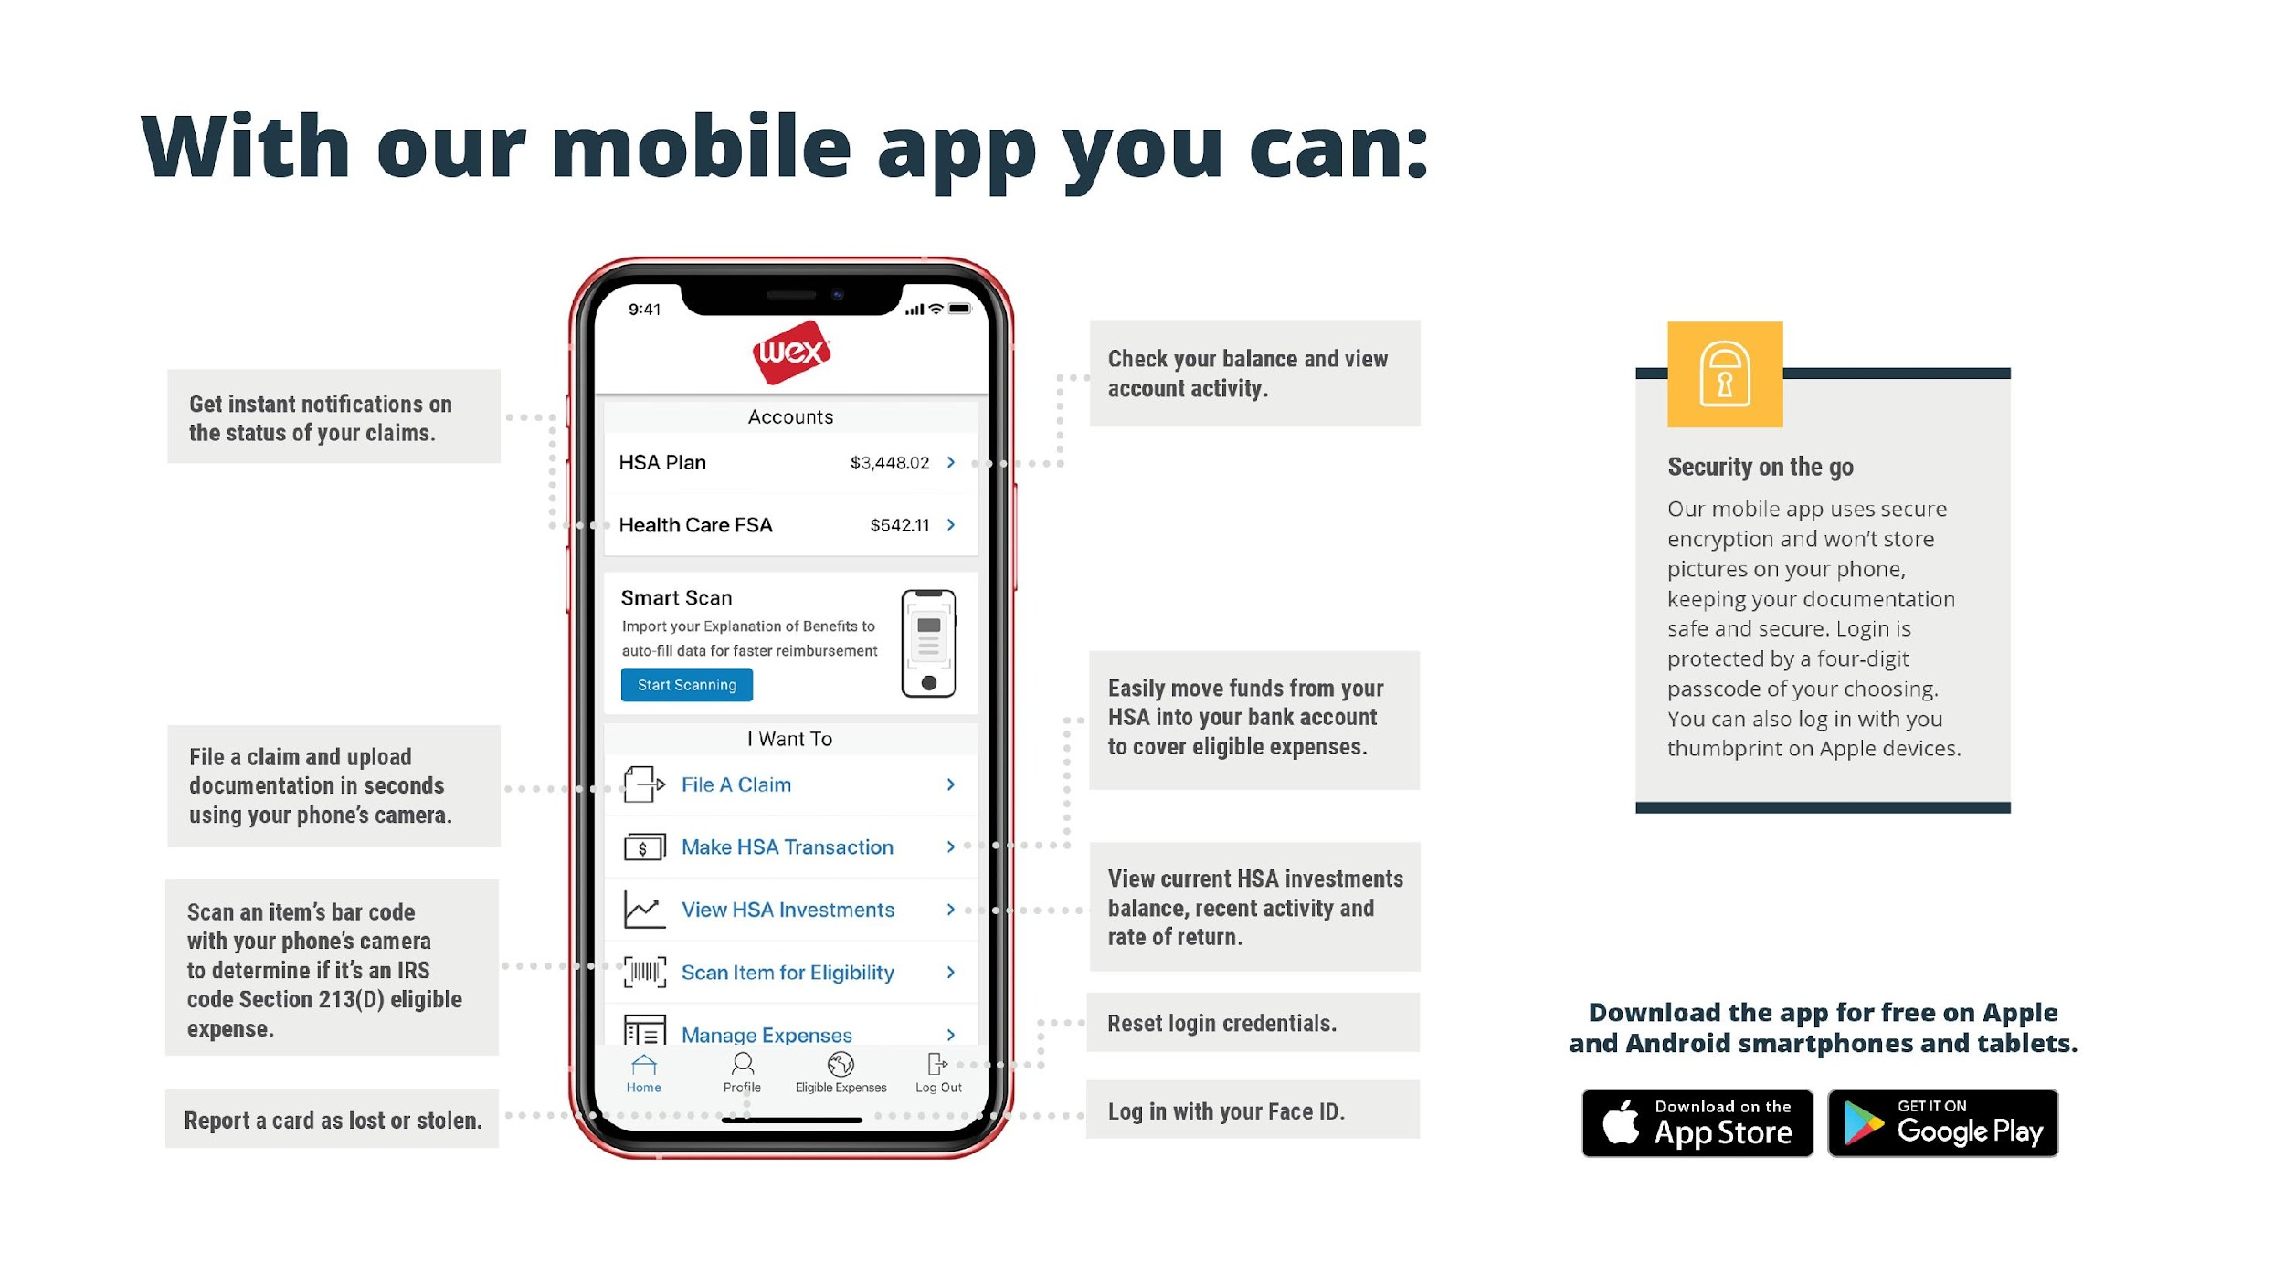

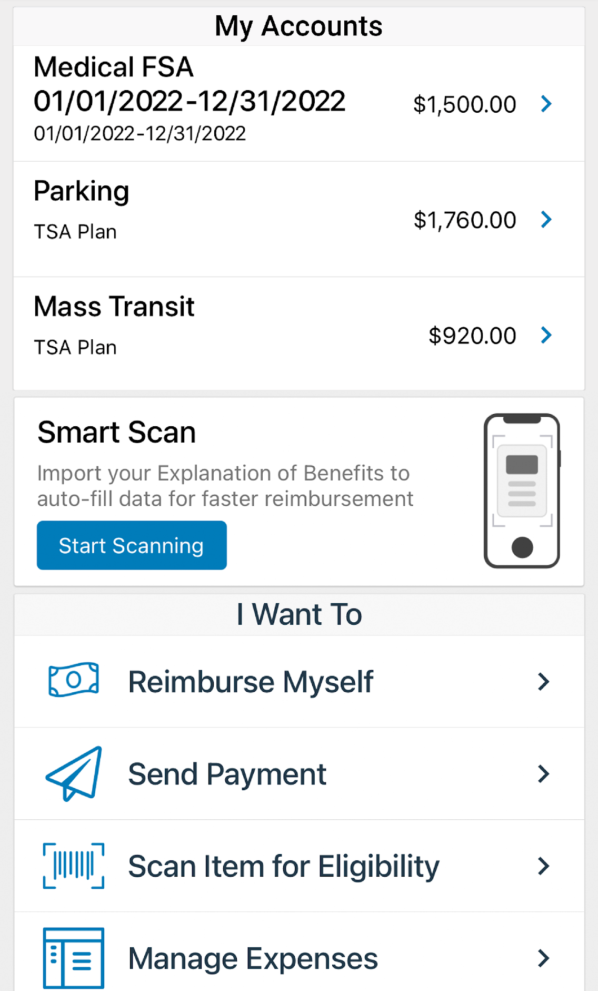

With our mobile app you can:
Check your balance and view your activity.
Get instant notifications on the status of your claims.
Security on the go
Easily move funds from your HSA into your bank account to cover eligible expenses.
Security on the go
Our mobile app uses secure encryption and won’t store pictures on your phone, keeping your documentation safe and secure. Login is protected by a four-digit passcode of your choosing. You can also log in with your thumbprint on Apple devices.
Our mobile app uses secure encryption and won’t store pictures on your phone, keeping your documentation safe and secure. Login is protected by a four digit passcode of your choosing. You can also log in with your thumbprint on Apple devices.
File a claim and upload documentation in seconds using your phone’s camera.
View current HSA investments balance, recent activity, and rate of return.
Scan an item’s barcode with your phone’s camera to determine if it is an IRS code 213(D) eligible expense.
Reset login credentials.
Login with your Face ID.
Report a card as lost or stolen.
Notes:
The WEX mobile app provides you with quick easy access to your online account. After logging in the first time, you can set up fingerprint access right from your phone.
Other great features include:
Take a photo of your explanation of benefits or itemized receipt in order to submit documentation for any outstanding claims. This saves a ton of time since you don’t have to scan an email receipt and upload it manually.
Easily check your account balance while standing in line at the store, making it easy to decide if you want to use your plan dollars to cover a purchase.

Slide 12

Contact Participant Services
Our Participant Services team is available Monday through Friday, from 6 a.m. to 9 p.m. CT, except holidays.
Live Chat
––––
Log into your online account
Website
––––
www.wexinc.com
Phone
––––
Current WEX participants:
866-451-3399
New to WEX:
844-561-1337
Notes:
For any questions or assistance you may need, our participant services team is available to you Monday through Friday from 6 am to 9 pm Central time.
You have a variety of options to contact us. You can use the live chat feature by logging into your online account, get support on our website at www.wexinc.com, or call to speak to a participant services representative.
If participates ask for instructions…
Live Chat: from your online account, select Need Help? in the bottom right corner, which will open a virtual assistant window, then follow prompts.
Support on Website: To access the form, follow the below steps:
Navigate to www.wexinc.com > Support > Contact customer service team > Contact WEX benefits.
Select the following:
a. Type of Inquiry: Customer Service
b. I am a: Employee/Participant
Select “WEX Benefits Support Center”.
Complete the form.
A successful submission message will appear indicating that we'll be in touch.
The employee/participant will receive an email response with additional details or resolution to their inquiry.
Form URL: https://wexhealthinc.my.site.com/WEXbenefitscontactus/s/

